Slide 1

Personalized Movie Recommendation System
Based on User Preferences and Rating Analysis — An Intelligent ML-Powered Approach to Content Discovery
MACHINE LEARNING
COLLABORATIVE FILTERING
HYBRID RECOMMENDATIONS
P.MOHITH SANJAY
323129510041

Slide 2
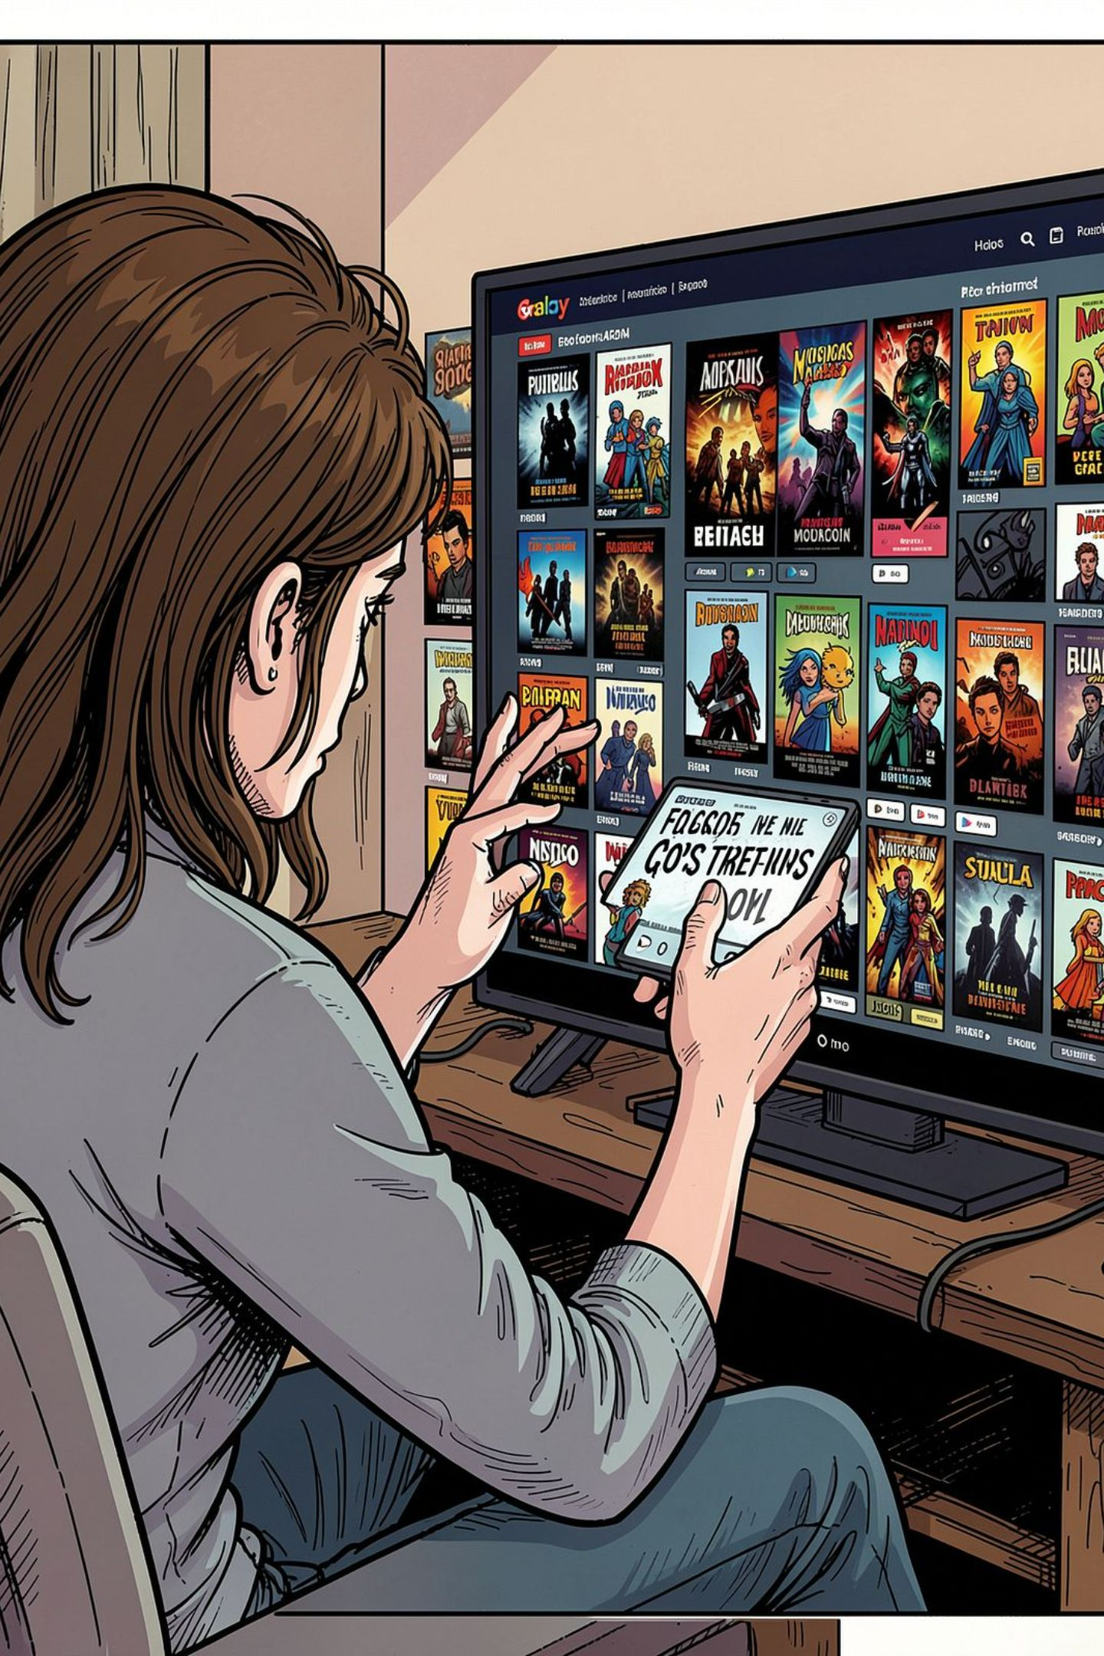
The Problem: Too Much Content, Too Little Discovery
Content Overload
Generic Suggestions
Streaming platforms host millions of titles, making meaningful discovery nearly impossible without intelligent guidance.
Traditional systems ignore individual preferences, serving the same trending list to every user.
Low Engagement
Poor personalization leads to user frustration, reduced watch time, and increased churn.

Slide 3



Existing Systems vs. Our Proposed Solution
Limitations of Current Systems
Our Intelligent Solution
No consideration of viewing history or rating behavior
Static recommendations that never adapt over time
Hybrid ML engine combining content-based and collaborative filtering
Continuous learning from ratings, history, and behavioral patterns
Single-algorithm approaches with high sparsity issues
No watchlist personalization or trend awareness
Multi-signal analysis: genres, actors, directors, and watch time
Personalized watchlists and real-time trending integration

Slide 4

System Architecture & Workflow
Collect Data
Preprocess Features
Dual-Engine Processing
Hybrid Scoring
The system operates as a continuous feedback loop — every user interaction refines the model, improving accuracy and relevance over time.

Slide 5

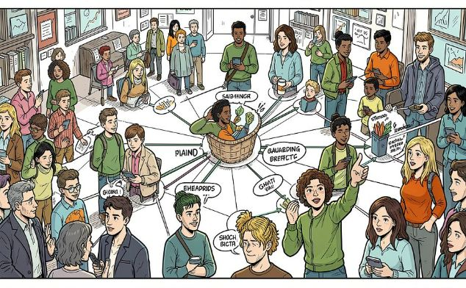

Core Recommendation Techniques
Content-Based Filtering
Collaborative Filtering
Hybrid Approach
Analyzes movie metadata — genres, cast, directors, keywords — to recommend titles similar to those a user has previously enjoyed.
Identifies users with similar rating patterns and recommends movies liked by similar users. Uses user-based and item-based KNN.
Combines both techniques with weighted scoring to overcome cold-start problems and improve coverage and accuracy simultaneously.

Slide 6
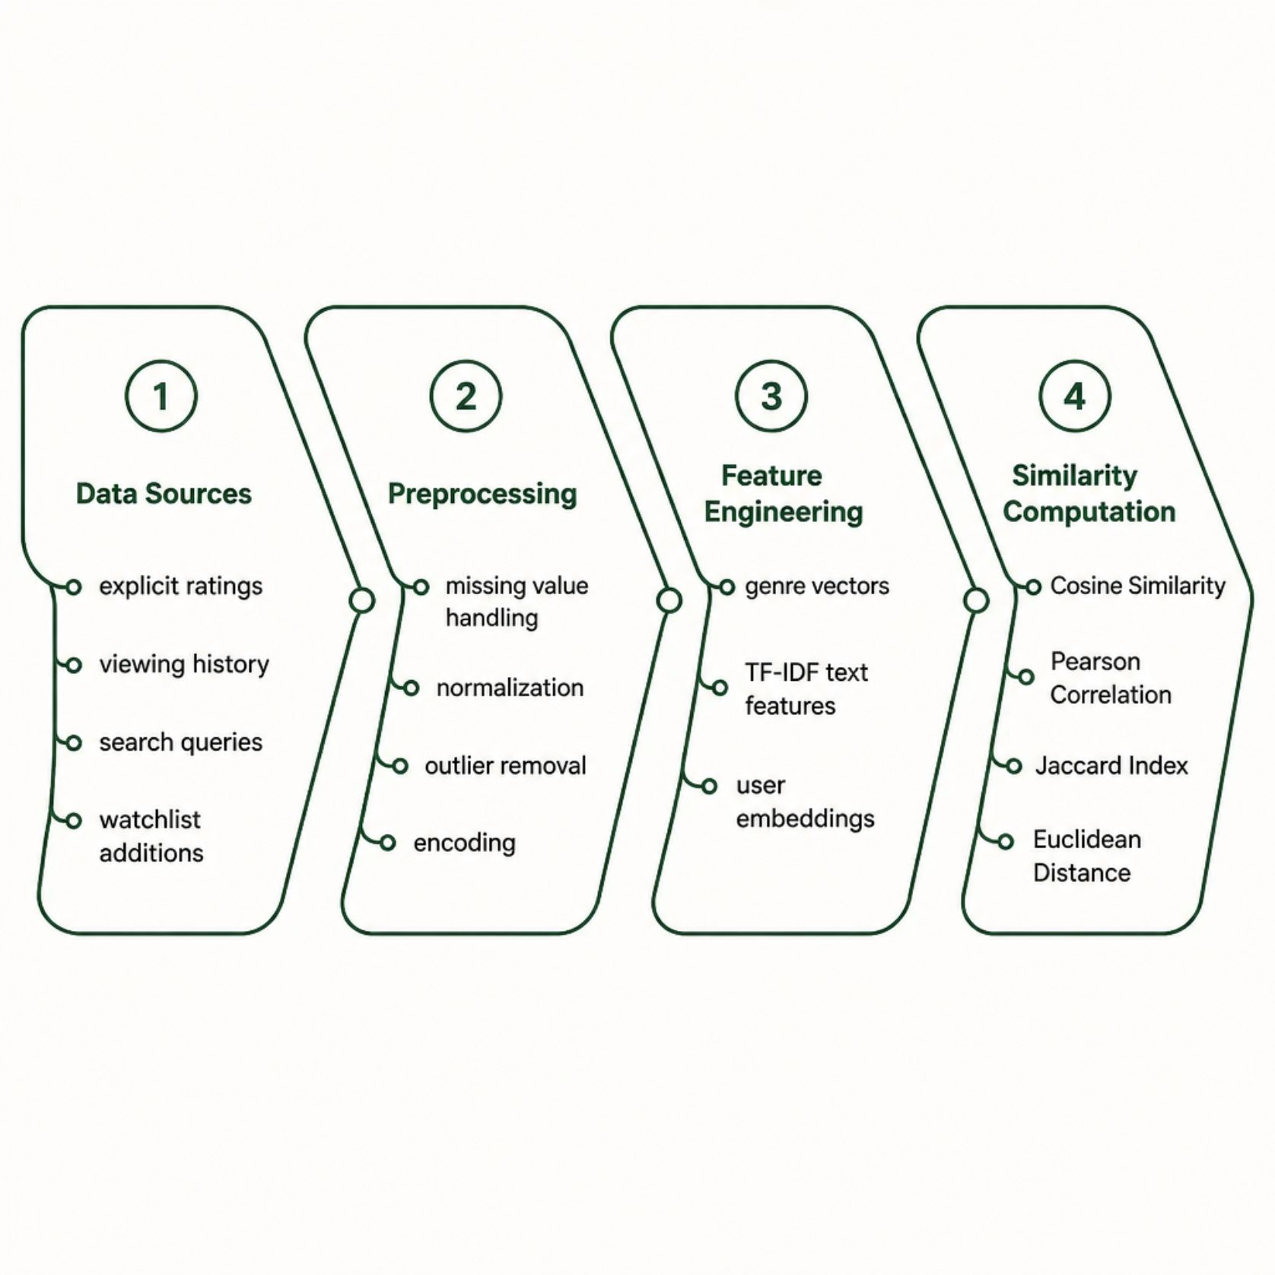
Data Collection, Preprocessing & Similarity Measurement
What We Analyze
Explicit signals: Star ratings, thumbs up/down, written reviews
Implicit signals: Watch duration, re-watches, search behavior
Preference vectors: Favorite genres, preferred languages, time-of-day patterns
Social context: Similar user clusters, trending within peer groups

Slide 7
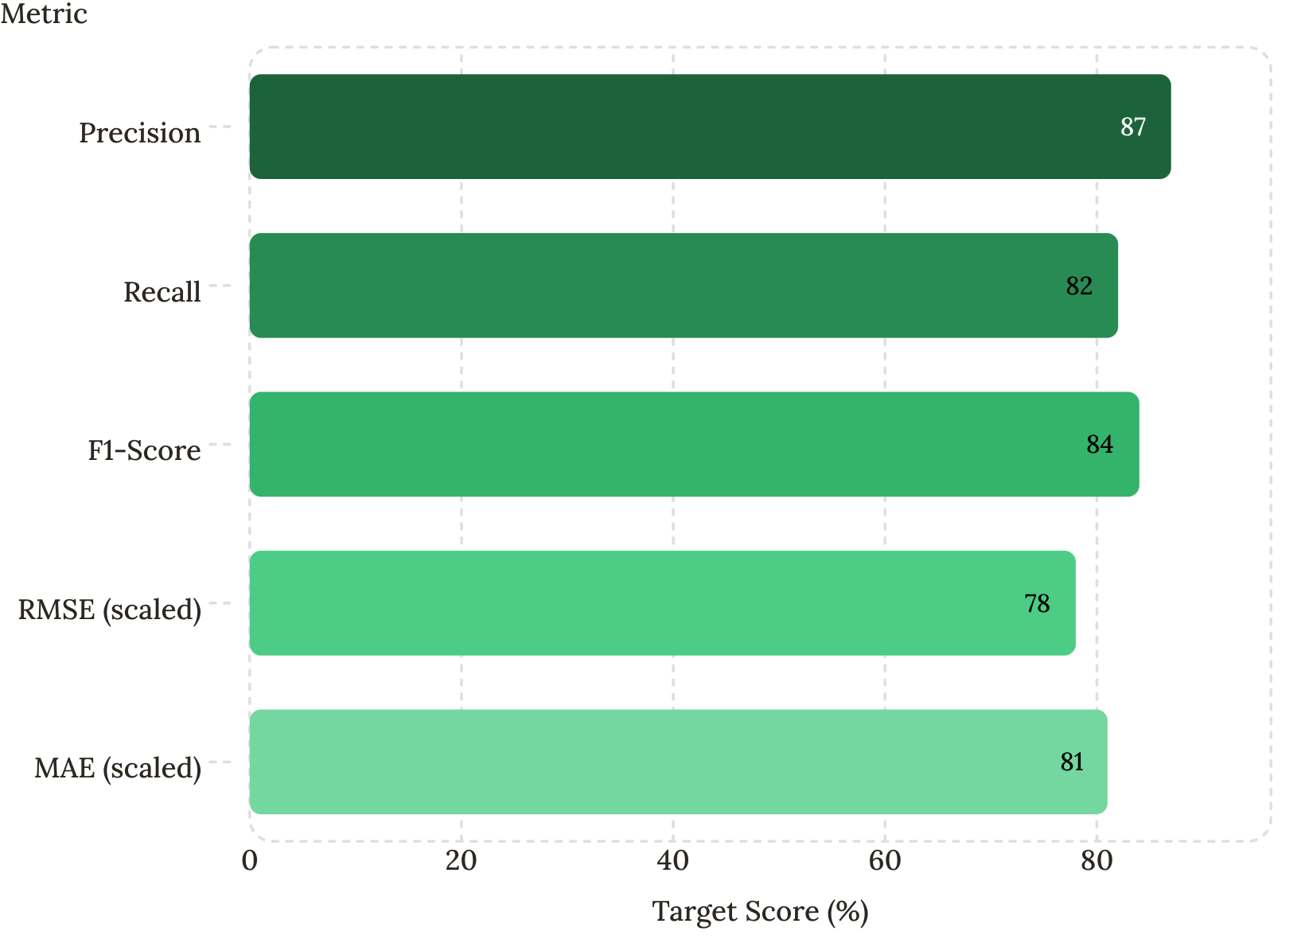

Model Evaluation Metrics
How We Measure Success
Precision & Recall: Measure relevance and coverage of recommendations
F1-Score: Harmonic mean balancing precision and recall
RMSE & MAE: Quantify rating prediction error on test data
A/B Testing: Live comparison of algorithm variants in production
Target benchmarks are based on MovieLens 1M dataset baselines and industry standards.

Slide 8
Modules, User Roles & Technology Stack
User Roles
Technology Stack
End User
Administrator
Backend: Python, Flask / Django, Scikit-learn
ML Libraries: Surprise, TensorFlow, Pandas, NumPy
Browse, rate, build watchlists, receive personalized recommendations, view trending movies
Manage movie database, monitor analytics dashboard, configure ML parameters, generate reports
Database: PostgreSQL, Redis (caching)
Frontend: React.js, D3.js (analytics)
Security: JWT Auth, HTTPS, Role-Based Access Control

Slide 9




Advantages, Applications & Future Roadmap
Higher User Satisfaction
Increased Engagement
Relevant suggestions reduce decision fatigue and increase watch time.
Personalized watchlists and trending feeds drive daily active usage.
Scalable Architecture
Future Enhancements
Designed to handle millions of users and titles with low-latency inference.
Deep learning (Neural Collaborative Filtering), real-time streaming recommendations, multi-modal content understanding (visual + audio features), and cross-platform personalization.

Slide 10


Conclusion & Expected Outcomes
This system delivers a smarter, adaptive, and user-centric movie discovery experience by fusing collaborative filtering, content-based analysis, and continuous feedback learning.
87%
3x
Precision Target
Engagement Lift
Relevant recommendations delivered
Expected vs. non-personalized systems
24/7
Continuous Learning
Model updates with every interaction
A well-designed hybrid recommendation engine transforms passive browsing into an intelligent, personalized entertainment journey — driving satisfaction, retention, and platform growth.

